Slide 1
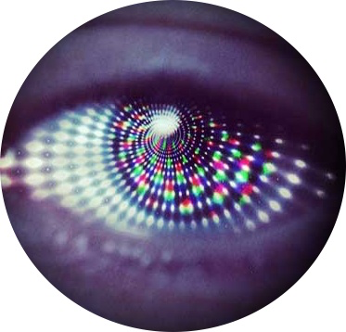
Hypnosis & Functional Neurological Symptom Disorder (FND) BSCAH Annual Conference June 2019
Dr Jason Price
Consultant Clinical Neuropsychologist
Dept. Neuropsychology,
The James Cook University Hospital, Middlesbrough
jasonprice1@nhs.net

Slide 2
What is fnd?

Slide 3
condition of disrupted movement, sensation, cognition, and perception that is not associated with abnormal neurophysiology or structural Physical defect

Slide 4
That doesn’t mean that the CNS is working normally however…. Substantial evidence that neural functioning is different in patients with FND

Slide 6
Historical context – Hysterical Neuroses
Jean-Martin Charcot
French Neurologist
Traumatic Hysteria
Hypnosis
Pierre Janet
Coined ‘dissociation’
Saw dissociation as a maladaptive trait of the ‘hysteric’
Josef Breuer
Hypnotic technique with hysteria
Freud colleague
Sigmund Freud
Studied under Charcot 1885
Developed the ideas of traumatic unconscious
= Psychoanalysis using free-association instead of hypnosis
Dissociation as defence mechanism

Slide 7
Terminology – DSM-5
DSM-5:
DSM-5 has now specified ‘Functional Neurological Symptom Disorder’ as an alternative label to ‘Conversion Disorder’:
With weakness or paralysis
With abnormal movement (e.g. Tremor, dystonic)
With swallowing symptoms
With speech symptoms (e.g. Dysphonia, slurred speech)
With attacks or seizures
With anaesthesia or sensory loss
With special sensory symptoms (e.g. Visual, olfactory, balance)
With mixed symptoms
Dissociative amnesia (300.12) and Depersonalization/Derealization Disorder (300.6) coded separately
To specify acute/persistent & with/without stressor.

Slide 8
Terminology for FNSD
ICD-10:
Dissociative/Conversion Disorder (F44.0 – F44.9 – includes dissociative amnesia)
Dissociative motor disorders (F44.4)
Dissociative Convulsions (F44.5)
Dissociative anaesthesia & sensory loss (F44.6)
Neurasthenia (F48.0)
Depersonalisation/Derealisation (F48.1)
ICD-11 – revision expected to include FNDS

Slide 9
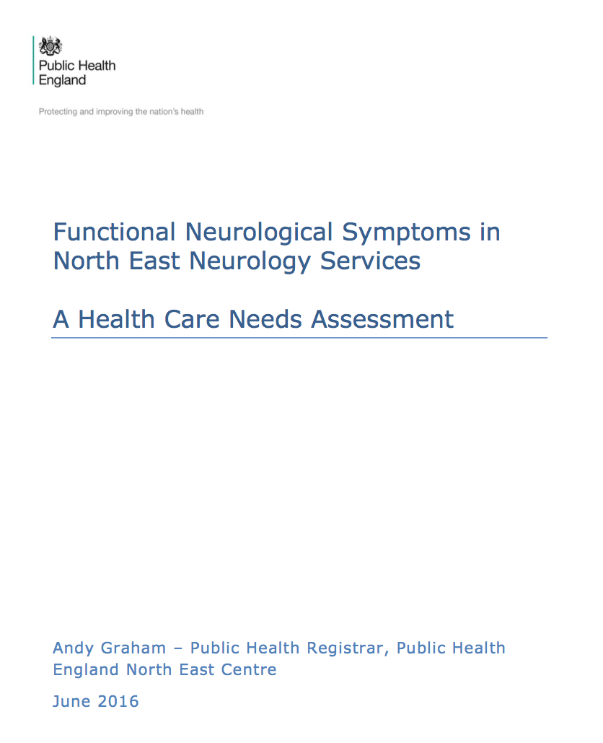
FNSD Epidemiology
Around 1/3 of patients presenting to Neurology outpatients with symptoms such as blackouts, collapse, somatosensory disturbance, weakness, which are primarily FND (Graham, 2016; Stone et al. 2010).
Approximately 10% of stroke admissions are ‘functional’ (Gargalas et al., 2015)
Approximately 7% of MS patients also have co-morbid functional symptoms
Up to 29% of patients with epilepsy have co-morbid NES.
Substantial overlap with chronic health conditions such as pain, CF/ME, fibromyalgia

Slide 10
Traditional psychological models of FND
Trauma/Threat models:
Psychodynamic:
Defence mechanism against unacceptable unconscious impulses, thoughts, memories, images etc., breaking through into conscious awareness
‘Conversion’ of psychological distress into physical symptom
‘Safe’ re-enactment of trauma situation to help gain ‘mastery’ (i.e. psychodynamic exposure therapy!)
C/B/T:
Avoidance of distressing stimuli
‘Panic without panic’
Learned behaviour – (classical/operant conditioning, SLT)
Evolutionary & Psychobiology:
Fight/Flight/immobilisation
Arousal regulation

Slide 11
Up to 75% of non-epileptic seizure patients have significant trauma backgrounds
Up to 2/3rd motor/movement disorder patients have trauma histories….

Slide 12
25% of NES patients and 1/3rd functional motor/movement DO NOT have trauma histories
Significant proportion of motor/movement patients have precipitating physical events
Traditional psychological theories also don’t adequately explain the ‘mechanism’

Slide 13
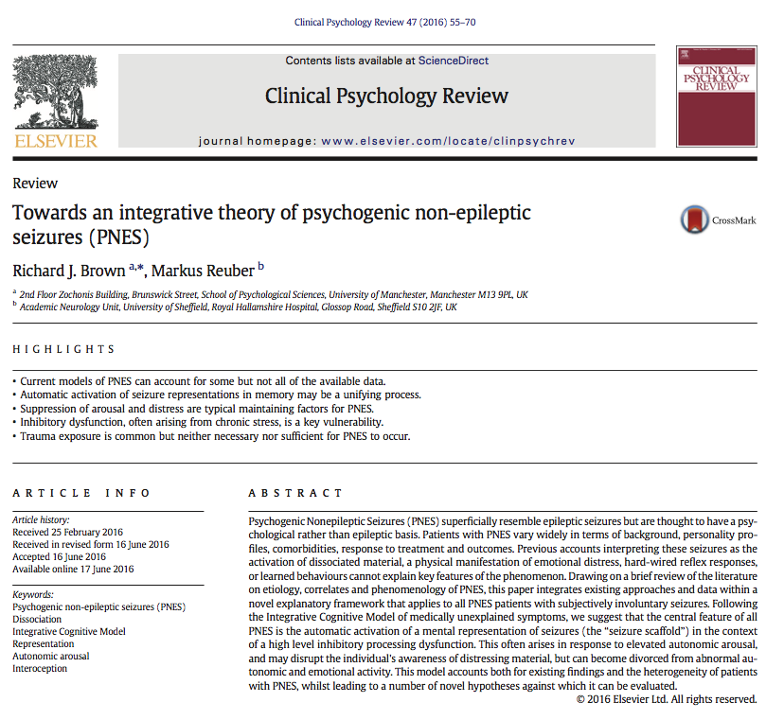
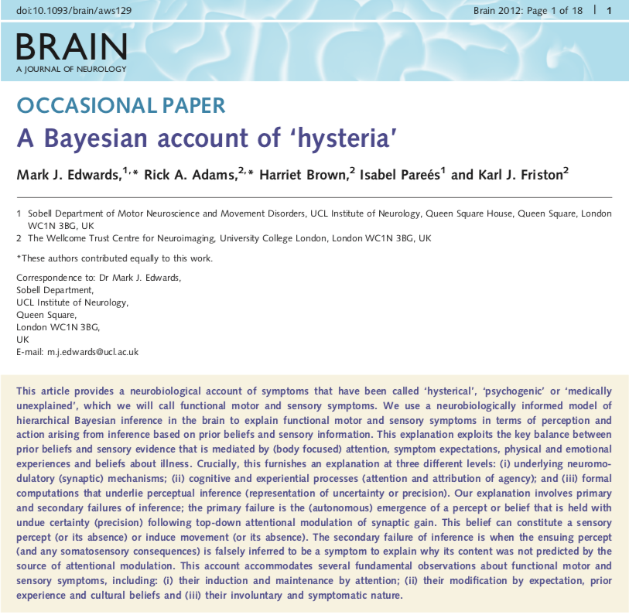
Neurocognitive Models

Slide 14
Neurocognitive models
Mark Edwards ‘A Bayesian Account of Hysteria” (2012) - Information processing approach
Top down + bottom up data driven model – model of normal functioning, but explains how FND symptoms manifest
Emphasises maladaptive attention & attenuation; prediction errors
ATTENTION; BELIEFS & pattern recognition; AGENCY (Edwards, M.J. et al., 2013; Neurobiology of functional (psychogenic) movement disorders)
Not at odds with psycholopathology models

Slide 15
Bayesian Brain in FND
Biological organisms prefer homeostasis to entropy
Schemas of how we and the world work produce ‘hypothesis’ (expectations, beliefs) which serve to minimise entropy (and preserve homeostasis)
Resulting ‘bottom up’ data (evidence) can either be consistent or incongruent with model.

Slide 16
Bayesian Brain
An adaptive system will be able to tolerate a degree of unexpected outcome and flex the model to either assimilate or accommodate incongruent data – the system evolves/improves.
A maladaptive system is extreme, inflexible and ‘intolerant’ and resists ‘acceptance’ of the incongruent data by modulating attentional systems away from it and fixating attention on congruent information (or misinterpreting ambiguous signals), to maintain it’s position.:
The result is an overly dominant ‘top down’ process which ‘fits’ the world into its view, rather than adapting with the evidence….

Slide 18
FND symptoms occur when an overly dominant (and incorrect) schema is formed and then resists incoming ‘bottom up’ incongruent evidence, or misinterprets ambiguous signals as confirmatory data
Can be formed by psychological or physical agonists
This process is facilitated by attentional mechanisms, maladaptive beliefs and a lack of a sense of agency:
e.g. broken escalator phenomenon, vibrating phone

Slide 19
Sir James Paget – Nervous Mimicry
She says…. ‘I cannot’; it look like ‘I will not’, but it is ‘I cannot will’

Slide 20
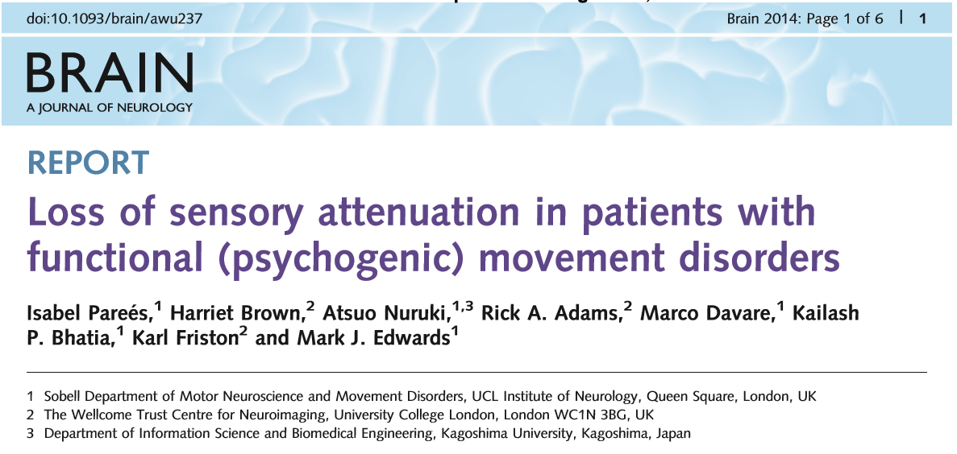
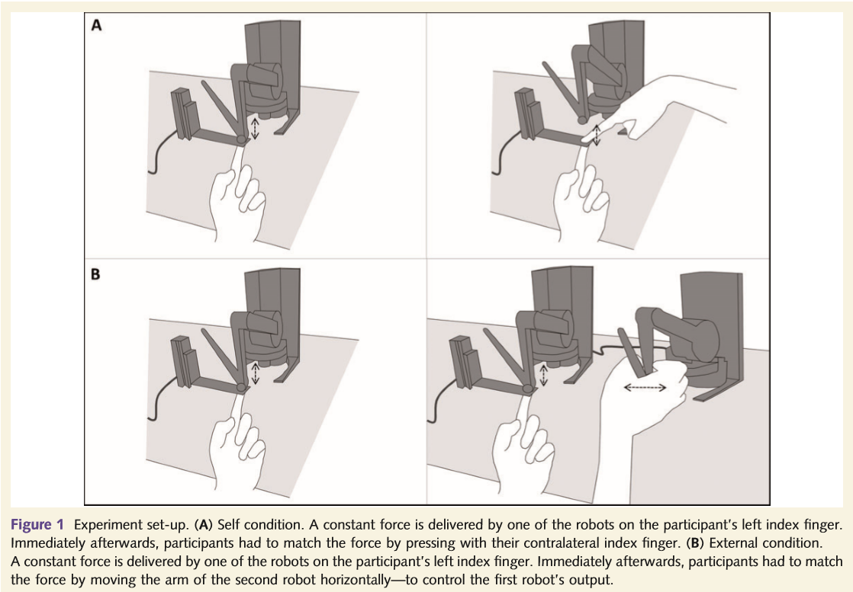
Functional motor patients have excessive attentional focus on affected limb.
Also evidenced in lack of normal ‘distraction’ of emotional stimuli in grip strength

Slide 21
Let’s create a (transient!) functional symptom!

Slide 22
What does Hypnosis have to do with FND?
e.g. David A. Oakley, Peter Halligan, Quinton Deeley, Devin Terhune:
Hypnosis can reproduce functional symptoms
Hypnosis can remove above symptoms
Hypnosis can modulate attentional systems
Hypnosis can ‘turn off’ the neural circuits involved in agency
Hypnosis can ‘turn off’ processes involved in self-monitoring
Hypnosis can ‘turn off’ automatic neuropsychological processes
EEG, fMRI evidence
Consideration in Cochrane review for Conversion Disorders

Slide 23
Hypnosis & Neuroscience Evidence
fMRI (N=57) hypnotic vs non hypnotic tasks: “These changes in neural activity underlie the focused attention, enhanced somatic and emotional control, and lack of self-consciousness that characterizes hypnosis”
Hypnosis can modulate the interconnection between the default mode network, executive control network and salience network
Jiang, H. et al. (2017), Cerebral Cortex

Slide 24
What does Hypnosis have to do with FND?
Modifying the ‘Bayesian Brain’:
Hypnosis involves top-down regulation of consciousness (review; Terhune, DB et al., 2017)
Development of cognitive neuroscientific understanding of hypnosis has developed alongside contemporary cognitive neuroscience understanding of FND.

Slide 25
Hypnosis & Neuropsychological Evidence
Kihlstrom, J.F. (2013) Neuro-Hypnotism: Prospects for Hypnosis & Neuroscience,Cortex, 49(2) 365-74
Review
“This instrumental use of hypnosis is particularly well-suited for identifying the neural correlates of conscious and unconscious perception and memory, and of voluntary and involuntary action”
Hypnosis nullifies automatic neural processes (dominant top down processes) in High Hypnotizable subjects (e.g. Stroop Effect)

Slide 26
Automatic Neuropsychological processes: reading
For emaxlpe, it deson’t mttaer in waht oredr the ltteers in a wrod aepapr, the olny iprmoatnt tihng is taht the frist and lsat ltteer are in the rghit pcale. The rset can be a toatl mses and you can sitll raed it wouthit pobelrm

Slide 27
Stroop effect

Slide 28
Hypnosis Recreates Functional Amnesia
Jamieson, G.A. et al (2017):
Hypnotic amnesia for previously seen faces
EEG; Alpha changes; N=24
Top down control processes activate lower level responses
Process ‘protected’ from incongruent (accurate) feedback from internal/external information
Alpha changes consistent with decreased (i.e. inhibited) activity in face processing cortex in HH in amnesic condition
Reversed when removed from suggestion!

Slide 29
Lindelov et al. (2017): RCT
27 TBI patients; 4 x 1 hour sessions
WMI (WAIS-III); TMT
Direct suggestions for improved WM capacity by hypnotic regression to pre-injury status and imagery of brain plasticity
Outcome goal– return to pre-morbid level of functioning/within range or healthy population
Medium effect improvement compared with 22 active controls; very large improvement compared to 19 active controls (Bayes Factor)
Improvements held at 7 week f/u
“Indication that there may be a residual capacity for normal information processing in the injured brain.”
Nemeth, D.et al. (2013), Boosting Human learning by Hypnosis, Cerebral Cortex, 4(1), 801-805
Counterbalanced alert/hypnotic trance
Sequence Learning task
‘Turning off’ the conscious executive control improves procedural learning
FUNCTIONAL OVERLAY?

Slide 30
Moene et al. (2003)
Hypnosis RCT for motor conversion disorder
N=44
Manualised, 10 weekly 1 hour sessions; 1 preparatory session; fidelity assessments
30 minutes self-hypnosis each day
Direct suggestions for symptoms alleviation; emotional expression/insight direction
Significant improvement on behavioural symptoms at end of therapy and maintained at 6 month follow-up
No significant differences on general measures of psychological pathology (SCL-90)

Slide 31
Hypnotic strategies for working with FND Moene et al. (2008); adapted from Deeley, Q. (2016)
Motor FND:
Direct attention upon affected limb; encourage awareness of sensation/movement; positively reinforce (NEED TO BE CAREFUL HERE!)
Direct attention upon non-affected limb; encourage awareness of sensation/movement; positively reinforce; suggest that these sensations will flow/transfer to the unaffected limb (hypnotic variation of mirror box intervention!)

Slide 32
Hypnotic strategies for working with FND Moene et al. (2008); adapted from Deeley, Q. (2016)
Motor FND:
Imagination of normal functioning in the past (used in successful mental imagery retraining in stroke); stimulating pre-motor circuits by strong, memory reinforced imagery
Relaxation: [be creative!] general relaxation; specific relaxation of target areas (e.g. of functional spasticity)
Imagination: using imagery to increase function in novel ways (e.g.rolling a ball with foot, balloon in hand)
Functional tremor/shaking:
‘Letting go’ – relaxing, not resisting, shaking off (tensing increases symptoms)
Incongruent imagery (e.g. imagining limbs as heavy an flaccid to reduce movement – similar to HRT in Tourette’s intervention)
Imagery for sleep

Slide 33
Hypnotic strategies for working with FND Moene et al. (2008); adapted from Deeley, Q. (2016)
Somatosensory symptoms:
Direct suggestions for gently increasing awareness of [lost] sensations (e.g. vision, hearing, touch)
Can also use direct suggestions for symptom removal (need to be VERY careful with this to avoid therapeutic ‘rupture’ – consider as you would in a CBT behavioural experiment – great if it works, but need a solid ‘plan B’!)
Dissociative/NES:
Recreating or recalling dissociative state/event to gain mastery (perhaps using grounding techniques or attentional control)
Facilitating awareness of trauma images to gain mastery (e.g. desensitization, imagery restructuring, resource overlay; linking past trauma imagery with current symptoms – EMDR type procedures)

Slide 34
Hypnosis for stroke rehabilitation Diamond et al. (2006)
6 Case studies
Chronic (6-79 months post-stroke; median 32 months) stroke patients; hypnosis to overcome learned non-use of upper limb
3 stage hypnotic process after choosing a motor movement that could be performed before stroke:
Hypnotic imagining/remembering movement in past, then present
Imagining movement alternating with eyes closed, then eyes opened (creating an active-alert/waking hypnotic state)
Following high level of confidence in image, alternate imagined practice with physical performance

Slide 35
Hypnosis for stroke rehabilitation Diamond et al. (2006)
4 baseline sessions; 4 x 1 hour hypnosis sessions; 4 f/u sessions
Results:
Qualitative improvements in motor function:
Increase range of motion
Increased grip strength
Reduced spasticity
Increased awareness and Decreased perceived effort in using paretic limb
Improved outlook, increased motivation

Slide 36
Process similarities of FND & Hypnosis
FND | Hypnosis
Abnormal attention to maladaptive model of functioning | Modulates attentional ‘spotlight’
Misperception of ‘agency’ | Modulates sense of agency (FND pts. and HH do worse on Libert’s test
Maladaptive beliefs of function | Imagery ‘rescripting’
Maladaptive models of functioning ‘protected’ by selective attention processes which ‘guard’ against incongruent data to maintain homeostasis | Modulates self-awareness – can turn on or off
So that pretty much cements the partnership!

Slide 37
Hypnosis provides a Trojan Horse…

Slide 38
Conclusions
Hypnosis is already used as part of other ‘mainstream’ psychological interventions to treat FND (e.g. trauma ‘rescripting’ imagery, relaxation, sensory grounding)
Hypnosis and Mindfulness are congruent with cognitive neurocognitive models of bran/mind FND (e.g. ‘Bayesian Brain’) and sit (like bookends!) at the end of a spectrum of attention based psychological therapies:
Hypnosis would offer new treatment directions for FND patients:
Primary intervention – influencing the Bayesian Brain
Adjunctive to CBT, EMDR
Functional overlay in patients with co-morbid conditions such as epilepsy, MS, TBI, stroke

Slide 39
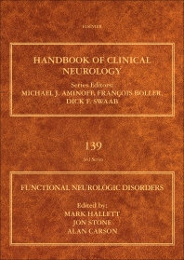
Thank you for your attention!

